Slide 1
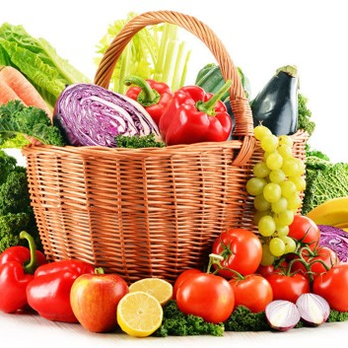
The Benefice Capel St Mary with Little Wenham and Great Wenham
Welcome To Our Harvest Festival
19th October 2023

Slide 2
Special Prayer For Harvest
Creator God
You made the world, and it is good.
The trees, mountains, rivers, and seas.
The birds, lions, ants and bees.
Creator God

Slide 3
You made us to care for the world and all its people.
Our planet is hurting. Many people are hurting.
Help us do what we can to bring healing to your creation and your people.
Amen

Slide 4
Genesis 1:27
So God created mankind in his own image, in the image of God he created them; male and female he created them.

Slide 5
Genesis 1: 31
God saw everything that he had made, and it was very good. And there was evening and it was the 6th day.
Thanks be to God.

Slide 6
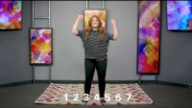

Slide 7
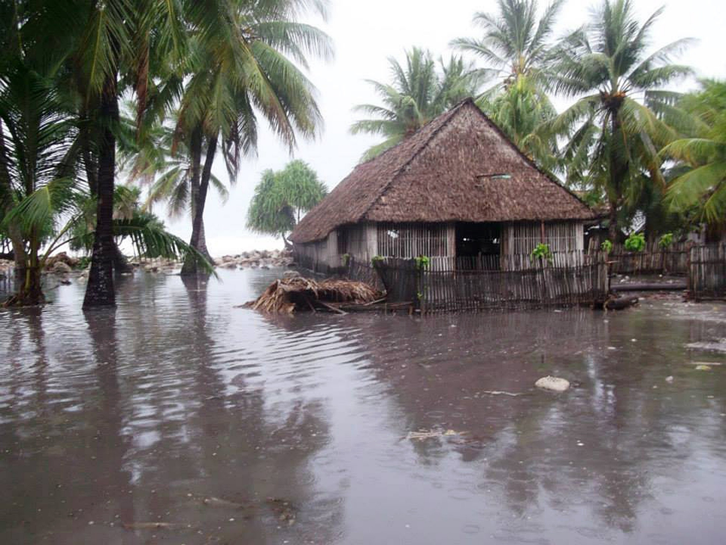

Slide 8
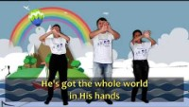

Slide 9
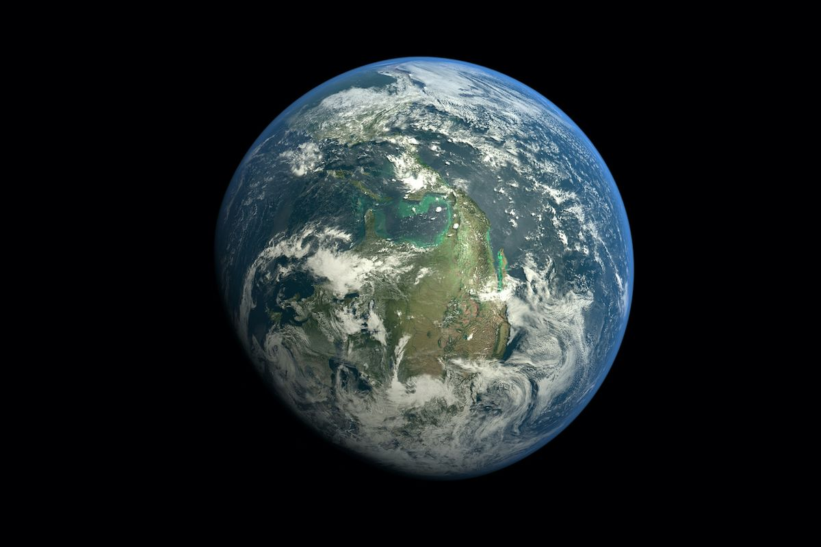
Where in the world are you connected to?

Slide 10
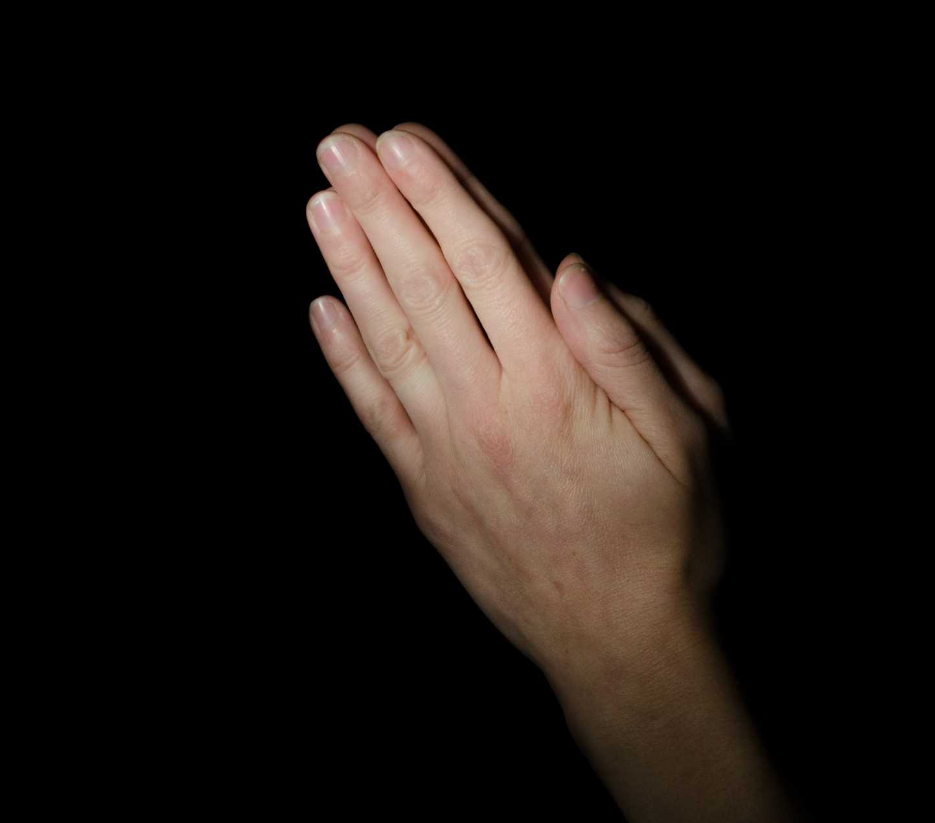
Prayers – Led By Jenny
Lord of the Harvest
Thanks be to God

Slide 11
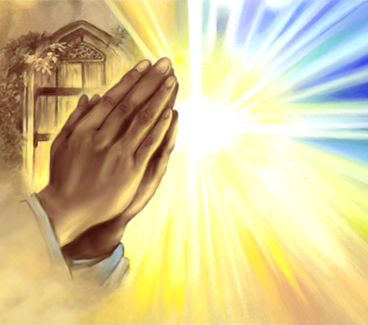
The Lords Prayer
Our Father, in heaven,
hallowed be your name;
your kingdom come;
your will be done;
on earth as in heaven.
Give us today our daily bread.

Slide 12
Forgive us our sins,
as we forgive those who sin against us.
Lead us not into temptation;
but deliver us from evil.
For the kingdom, the power and the glory, are yours now and forever Amen

Slide 13
Concluding Prayer
Dear Lord, help us not to worry about your world
Help us to do things that help us make your world better.
Thank you for all you do for us and the people we love
Amen

Slide 14


